Slide 1

SHREE RAMSWAROOP MEMORIAL UNIVERSITY
Assignment:-8
Java Enterprise Edition Lab - 08
Submitted to:
Submitted by:
Vidushi Srivastava
Mukesh Prajapati
Btech (Cse Industry integrated)
Roll No – 202410101230007

Slide 2
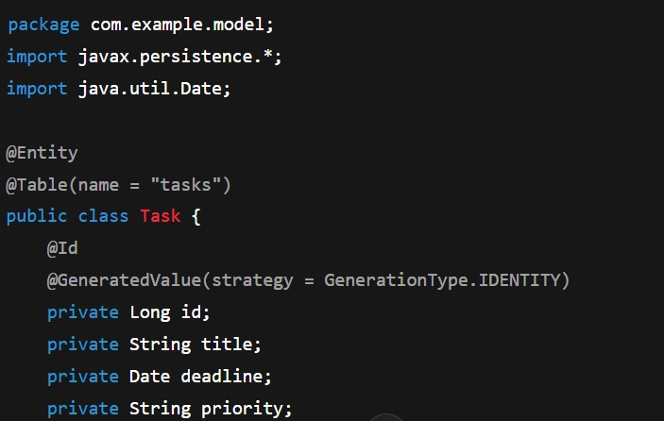
1. Configure JPA Entity
File: com/example/model/Task.java

Slide 3
2. JPA Configuration
File: src/main/resources/META-INF/persistence.xml
<persistence xmlns="http://xmlns.jcp.org/xml/ns/persistence" version="2.2">
<persistence-unit name="taskManagementPU">
<class>com.example.model.Task</class>
<properties>
<property name="javax.persistence.jdbc.url" value="jdbc:mysql://localhost:3306/taskdb"/>
<property name="javax.persistence.jdbc.user" value="username"/>
<property name="javax.persistence.jdbc.password" value="password"/>
<property name="javax.persistence.jdbc.driver" value="com.mysql.cj.jdbc.Driver"/>
<property name="hibernate.dialect" value="org.hibernate.dialect.MySQLDialect"/>
</properties>
</persistence-unit>
</persistence>

Slide 4
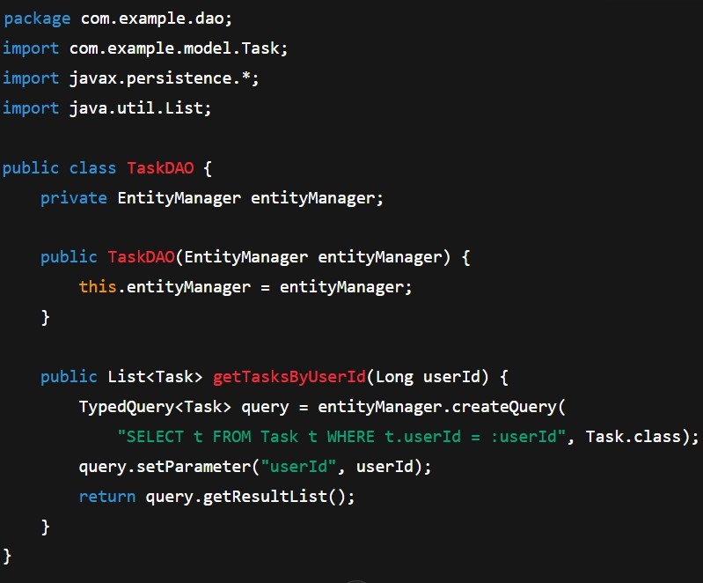
3. Create JPA DAO Class
File: com/example/dao/Task

Slide 5
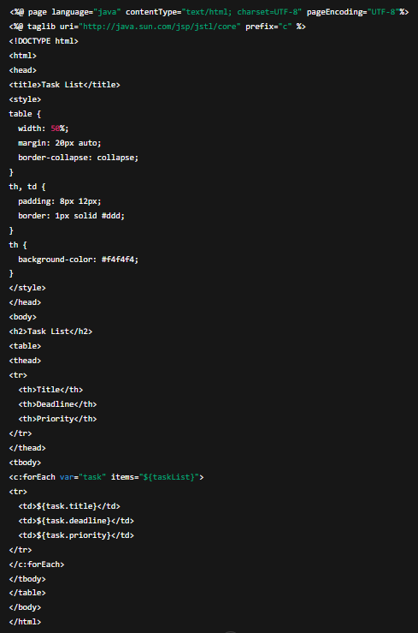
4. JSP Page – Task List
File: src/main/webapp/taskList.jsp

Slide 6
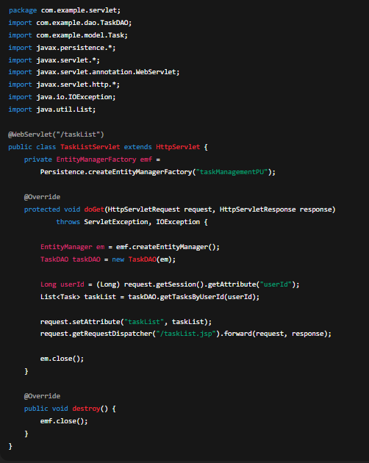
5. Servlet – TaskListServlet
File: com/example/servlet/TaskListServlet.java

Slide 7
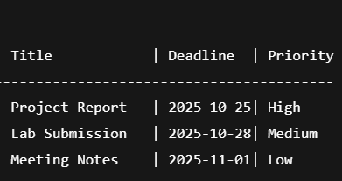
6. Output Preview (Simulation)

